Slide 1
Classroom Management System
Management of Classrooms of IUT using Real-time Cloud Database
05/10/2020

Slide 2

Meet our team
180041108
180041118
180041120
Tasnim Ferdous Anan
Sidratul Muntaha
Md. Farhan Ishmam

Slide 3


SCARCE FACILITIES
Too many students and rooms to be Manually Managed
Poor Management and Monitoring of routines and classrooms
Unscheduled Extra Classes and Quizzes Being scheduled along with regular classes

Slide 4
Management Information System
MIS
Real-time MANAGEMENT INFORMATION SYSTEM (MIS) for classrooms that can be accessed, updated and administrated by multiple categories of users from anywhere.
4

Slide 5
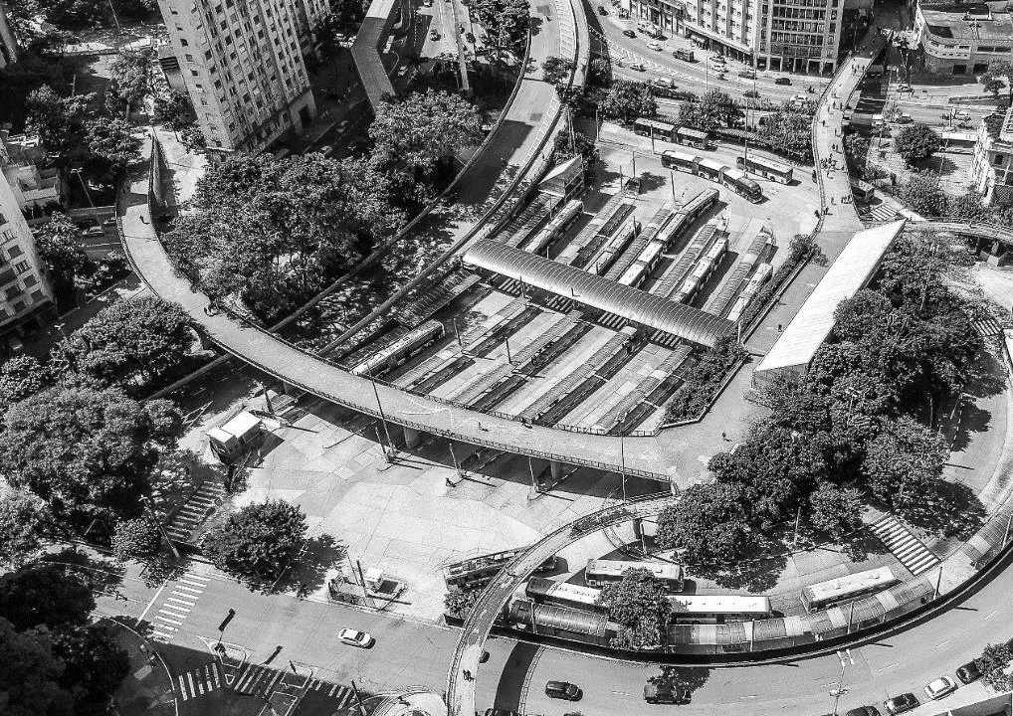




Teachers
Targeted Users
Students
Staff and Administration
Notes:
Photo by sergio souza on Unsplash
<a href="https://www.freepik.com/free-photos-vectors/business">Business vector created by katemangostar - www.freepik.com</a>

Slide 6
Goals and objectives
01
Real-time Access
classrooms at a particular time along with schedule-booking
02
Search and Book
classrooms based on our requirements according to the classroom features
03
Access and Modify
records booked by a user
04
Access Control
for different category of users

Slide 7
It’s easy with cloud computing”

Slide 8

Scope of the Project
01
Real-Time Cloud Based Database
02
Multi-Platform Compatibility
03
Graphical User Interface (GUI)

Slide 9

Thank You

